Slide 1
Introduction to Data Science
Tomas Karpati tc.datascience@gmail.com
054-2002430

Slide 2

Data Science

Slide 3
Data Science
Data science program - we will learn about:
Programming: SQL, R and Python
Tools used by data scientists
Data - Data types, data sources, data manipulation
Anatomy of a data science project
Data exploration
Data cleansing and completion
Data analysis - Machine learning
Communication of findings
Application of models into production
Project management from A to Z

Slide 4

Data Science

Slide 5


Slide 6
Data Science
What is DATA?

Slide 7
Data Science
Leters: a d t a
Words: data
Phrase: data science

Slide 8
Data Science
Data
Information
Knowledge
Leters: a d t a
Words: data
Phrase: data science

Slide 9
Data Science
What is
DATA SCIENCE?

Slide 10
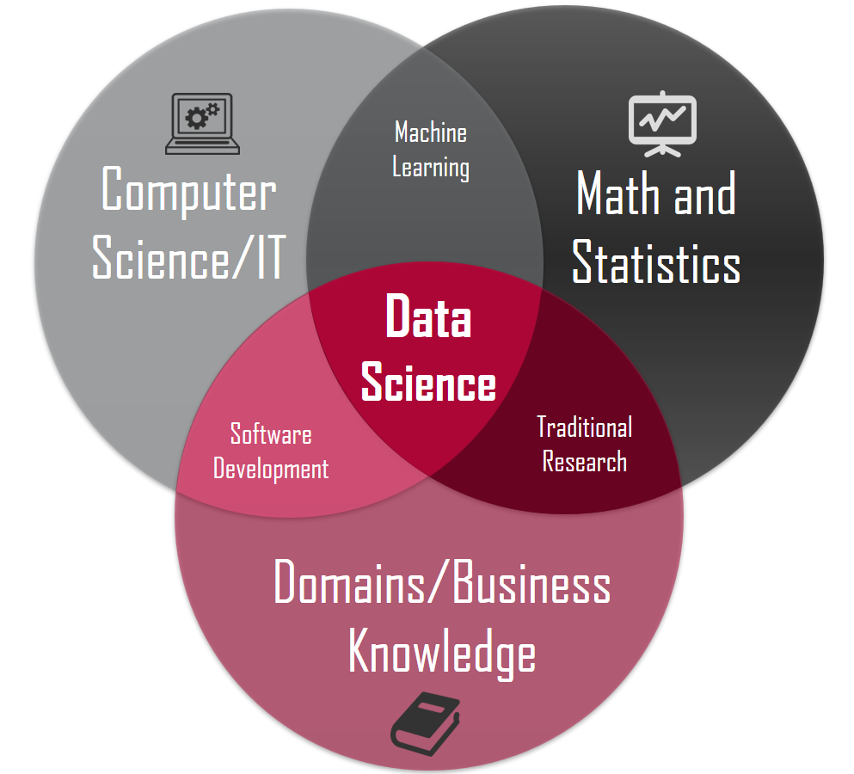
Data Science

Slide 11
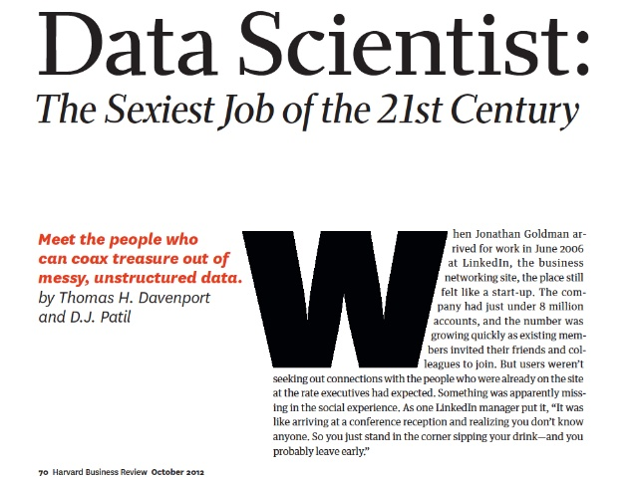

Data Science

Slide 12
Data Science
Who is a
DATA SCIENTIST?

Slide 13
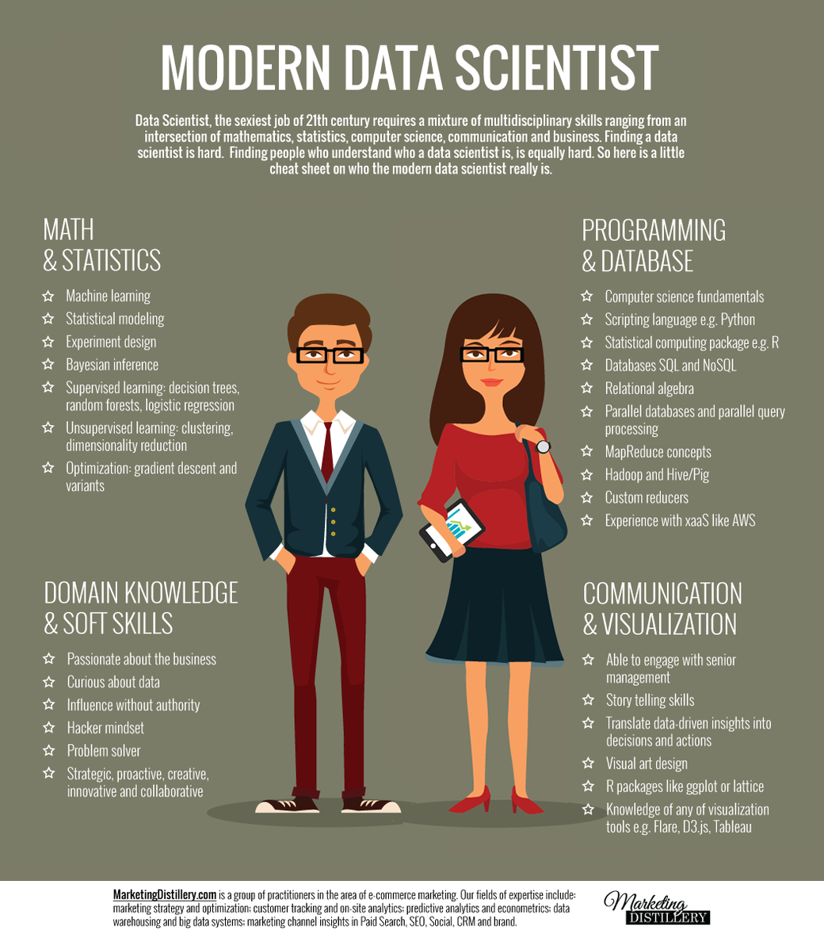

Data Science

Slide 14
Data Science
Why
DATA SCIENCE?

Slide 15
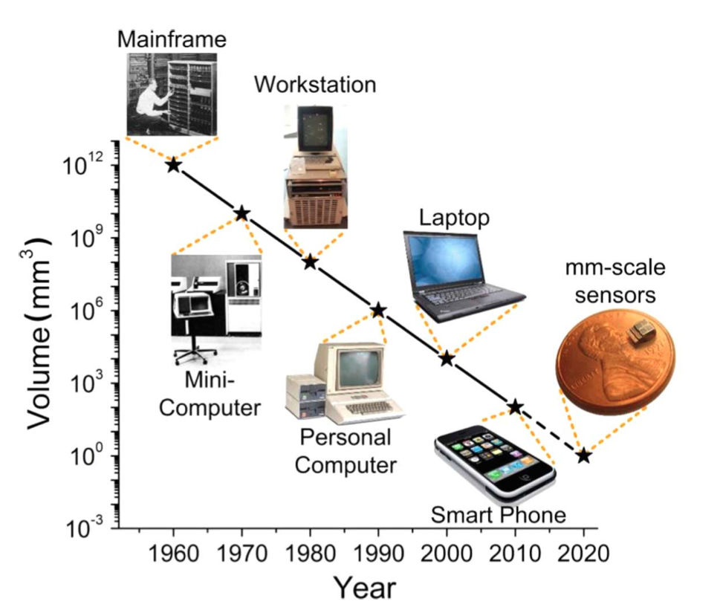
Data Science
Increase in computer power

Slide 16
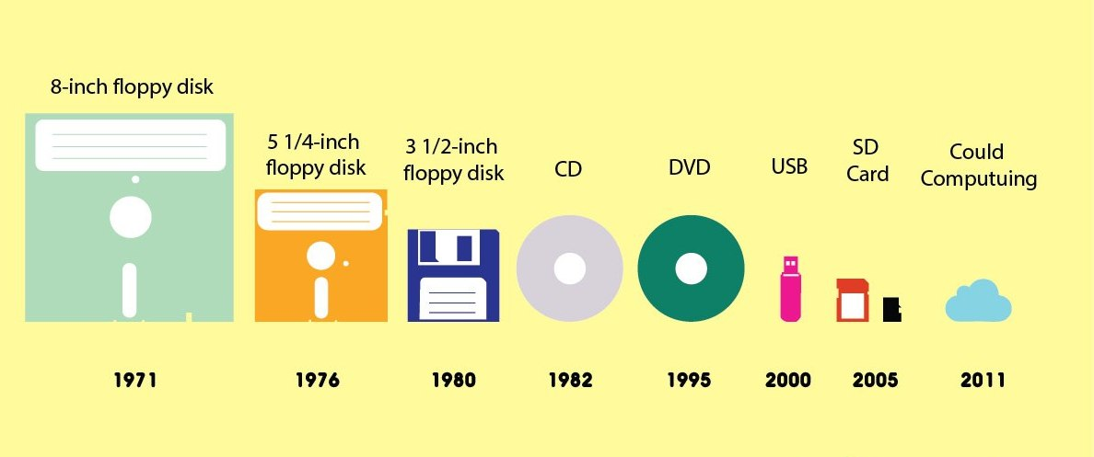
Data Science
Increase in storage capabilities

Slide 17
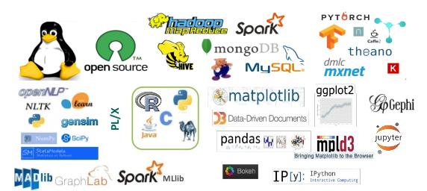
Data Science
Disruption of open source software

Slide 18







Data Science
Communities of Open Knowledge Share

Slide 19
Data Science
Statistics
vs
Data Science
vs
Artificial Intelligence

Slide 20
Data Science
Hypothesis Testing
Statistics
Model
Explanatory Variables
Machine Learning
Model
Prediction
Deployment
AI
Input
Model
Action
Output

Slide 21

Data Science
AI
example

Slide 22
Data Science
Scientific Research
vs
Data Science

Slide 23
Data Science
Scientific Method
Problem statement
Hypothesis
Methodology
Data retrieval
Data analysis
Reporting results
We ask a question that has no answer until now
Based on previous knowledge

Slide 24
Data Science
Scientific Method
Problem statement
Hypothesis
Methodology
Data retrieval
Data analysis
Reporting results
Try to give a possible answer (that we think is the most probable answer)

Slide 25
Data Science
Scientific Method
Problem statement
Hypothesis
Methodology
Data retrieval
Data analysis
Reporting results
Population definition.
Sample size and selection technique.
Measurement methods.
Variables definition.

Slide 26
Data Science
Scientific Method
Problem statement
Hypothesis
Methodology
Data retrieval
Data analysis
Reporting results
Data acquisition
Data save method

Slide 27
Data Science
Scientific Method
Problem statement
Hypothesis
Methodology
Data retrieval
Data analysis
Reporting results
Data aggregation:
- Central tendency methods
- Variability methods
Statistical methods
- Parametric
- Non-parametric
Data visualization

Slide 28
Data Science
Scientific Method
Problem statement
Hypothesis
Methodology
Data retrieval
Data analysis
Reporting results
Final Report
Presentation
Publication
Poster

Slide 29
Data Science
Scientific Method
Problem statement
Hypothesis
Methodology
Data retrieval
Data analysis
Reporting results
Data Science
Problem statement
Data retrieval
Methodology
Data analysis
Reporting results

Slide 30

Data Science
ANATOMY OF A
DATA SCIENCE PROJECT

Slide 31
Anatomy of a project
Domain Knowledge
Domain Knowledge:
Which questions do we want to answer ?
What is known about the problem?
How we define the outcome(s)?
What is known to influence the outcome?
Does we have any possible new knowledge that has not been in use before?
Design
Data preparation
Algorithms
Implementation
Production

Slide 32
Anatomy of a project
Domain Knowledge
Project Design:
Which is the best design for our goals?
How will we define the research subjects?
How will we clean, complete and exclude the data?
How will we validate our algorithms?
Write a research protocol !!!
Design
Data preparation
Algorithms
Implementation
Production

Slide 33
Anatomy of a project
Domain Knowledge
Data Preparation
Data extraction
Exploratory analysis of the data
Data cleansing
Data imputation
Data transformation, normalization and data engineering
Design
Data preparation
Algorithms
Implementation
Production

Slide 34
Anatomy of a project
Domain Knowledge
Algorithms:
Unsupervised vs Supervised methods
Model validation:
statistical tests
Partitioning of the dataset:
Cross-validation
Boosting
Feature selection
Hyperparameters fine-tuning.
Design
Data preparation
Algorithms
Implementation
Production

Slide 35
Anatomy of a project
Domain Knowledge
Implementation:
Selection of the best models
Model ensembling
Testing models in a new unseen dataset
Adaptation of the models to the real needs
Design
Data preparation
Algorithms
Implementation
Production

Slide 36
Anatomy of a project
Domain Knowledge
Production:
Inserting the models into production systems
Incorporation of the model results into the business logic.
Training employees on the interpretation of the predictions.
Consequences of using the models on policy / ethics issues.
Design
Data preparation
Algorithms
Implementation
Production

Slide 37
Recommended Reading
The medical AI insurgency: what physicians must know about data to practice with intelligent machines
D. Douglas Miller
https://www.nature.com/articles/s41746-019-0138-5

